Slide 1
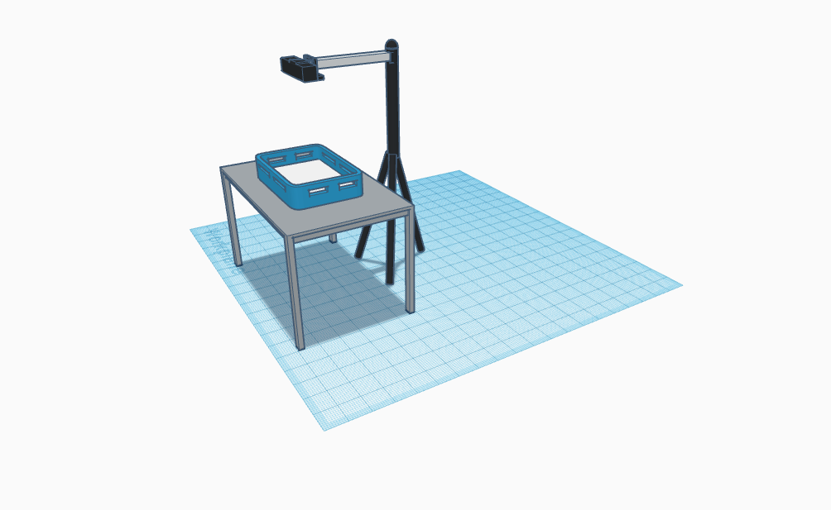
Counting and recognizing non-moving objects by means of image processing
ESAT1A1
Faculty of engineering science
Realised by
Max Beerten, Brent De Bleser, Wouter Devos,
Ben Fidlers, Simon Gulix, Tom Kerkhofs

